Slide 1

Machine Learning and Data Mining
Lecture 3.2: Generative Models and Naïve Bayes

Slide 3
Where are we?
We’ve covered a few techniques for fitting parameter:
Parameter Estimation:
Frameworks
Maximum Likelihood Estimation
Maximum A Posteriori
Optimization Tools
Gradient Descent

Slide 4
Where are we?
We’ve covered a few predictive models so far in class:
Predictive Models:
Classifiers (given x, produce discrete y)
k-Nearest Neighbors Classifier
Logistic Regression (binary classification only)
Perceptron (binary classification only)
Naïve Bayes Classifier (Today)
Regressors (given x, produce continuous y)
Linear Regression
k-Nearest Neighbors Regressor

Slide 5
Be able to answer:
What is a Bayes classifier?
How do generative and discriminative models differ?
What is a generative “story” for data?
How do we estimate a joint distribution for discrete variables?
What is the Naïve-Bayes classifier?
What assumption makes it “naïve”?
What is conditional independence in probability?
How do you fit conditional distributions
What is Bernoulli Naïve Bayes?
What is Categorical Naïve Bayes?
What is Gaussian Naïve Bayes?

Slide 6

Recall: Sources of Error
Bigger, more flexible function class
$$g^{∗}$$
More data or more data efficient algorithms
$$f$$
Modelling Error
Estimation
Error
$$g_{D}^{∗}$$
More expensive optimization algorithms or models with easier optimization
Optimization Error
$$g$$
$$ℋ$$

Slide 7
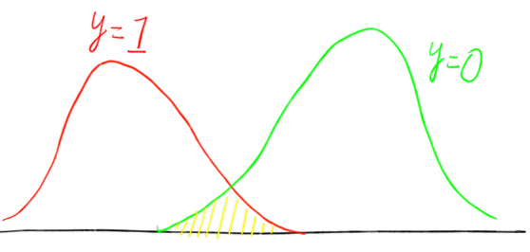
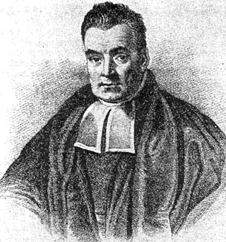
Recall: Sources of Error
Bayes Error Irreducible error inherit in the function being approximated – nothing we can fix.
$$g\left(x\right)=1$$
$$g\left(x\right)=0$$

Slide 8
Recall: Sources of Error
Bayes Error Irreducible error inherit in the function being approximated – nothing we can fix.
Likes Math | Reads ML News | Thinks MLE Is Cool?
0 | 0 | 0
1 | 0 | 1
1 | 1 | 1
1 | 1 | 0

Slide 9
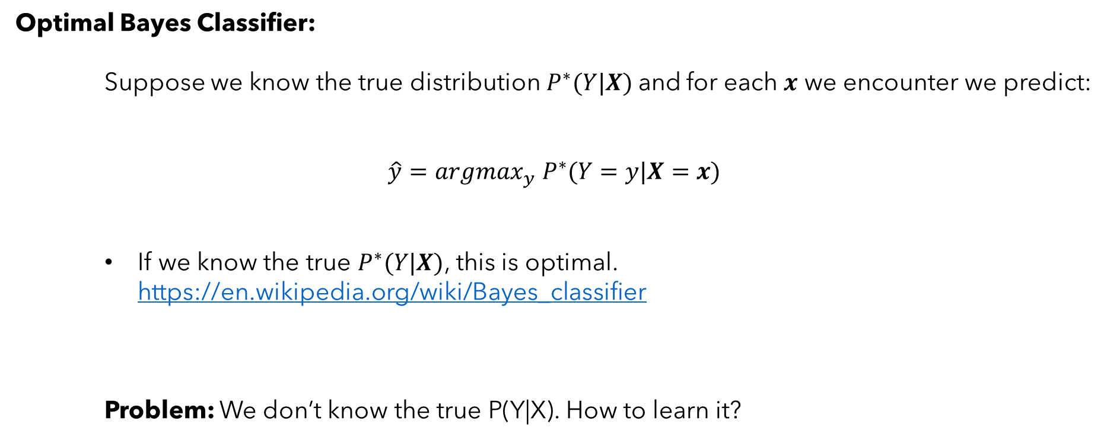
What is a Bayes Classifier?
Optimal Bayes Classifier:
Suppose we know the true distribution$P^{∗}(Y|X)$and for each $x$ we encounter we predict:
$$\hat{y}=argmax_{y} P^{∗}(Y=y|X=x)$$
If we know the true $P^{∗}(Y|X)$, this is optimal. https://en.wikipedia.org/wiki/Bayes_classifier
Problem: We don’t know the true P(Y|X). How to learn it?

Slide 10
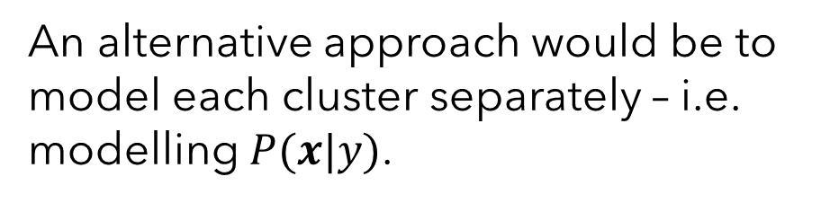
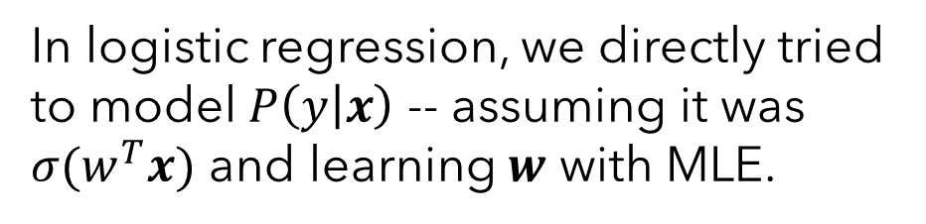
Generative vs. Discriminative Models
Problem: We don’t know the true $P(y|x).$How to learn it?
Consider the following binary classification problem (colors for labels):
In logistic regression, we directly tried to model $P\left(y | x\right)$ -- assuming it was $σ(w^{T}x)$ and learning $w$ with MLE.
An alternative approach would be to model each cluster separately – i.e. modelling $P(x|y)$.

Slide 11
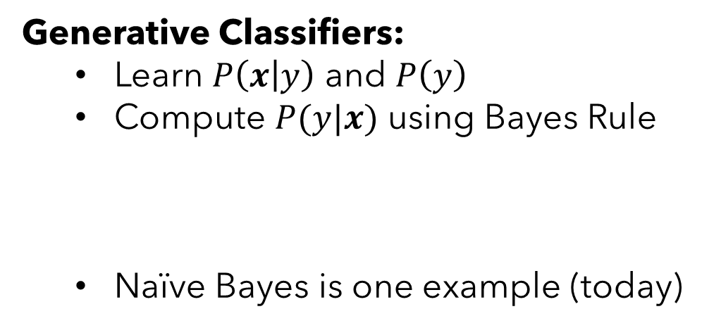
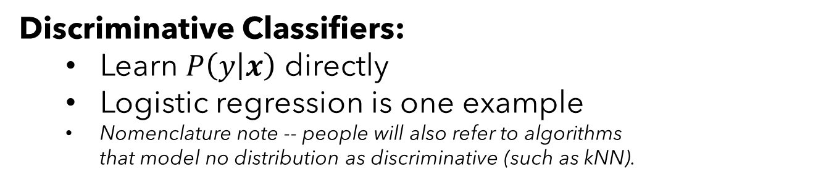

Generative vs. Discriminative Models
Discriminative Classifiers:
Learn $P\left(y | x\right)$ directly
Logistic regression is one example
Nomenclature note -- people will also refer to algorithms that model no distribution as discriminative (such as kNN).
Generative Classifiers:
Learn $P\left(x | y\right)$ and $P\left(y\right)$
Compute $P(y|x)$ using Bayes Rule
Naïve Bayes is one example (today)
$$P\left(y | x\right)=\frac{P\left(x | y\right)P\left(y\right)}{P(x)}=\frac{P\left(x | y\right)P\left(y\right)}{\sum_{y}{P\left(x | y\right)P\left(y\right)}}$$
Both classify according to argmax $P(y|x)$. Just learn and represent it differently.

Slide 12
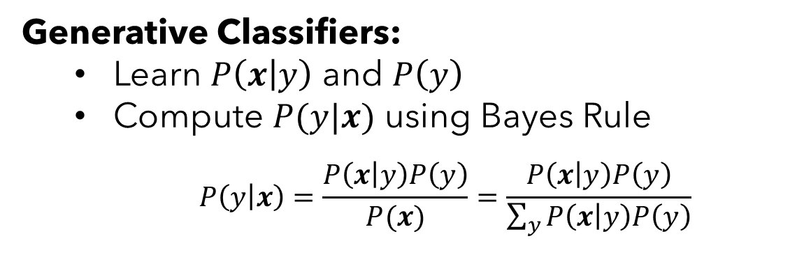
Generative Classifiers – Example 1: Studying Students
When defining a generative classifier, we are rather explicitly making a fictional story about how the dataset we observe was generated – the reading calls these generative stories.
Our modeling decisions combined with the data answer:
$P(y)$How are classes distributed?
$P(x|y)$ Given a class, how are features distributed?

Slide 13
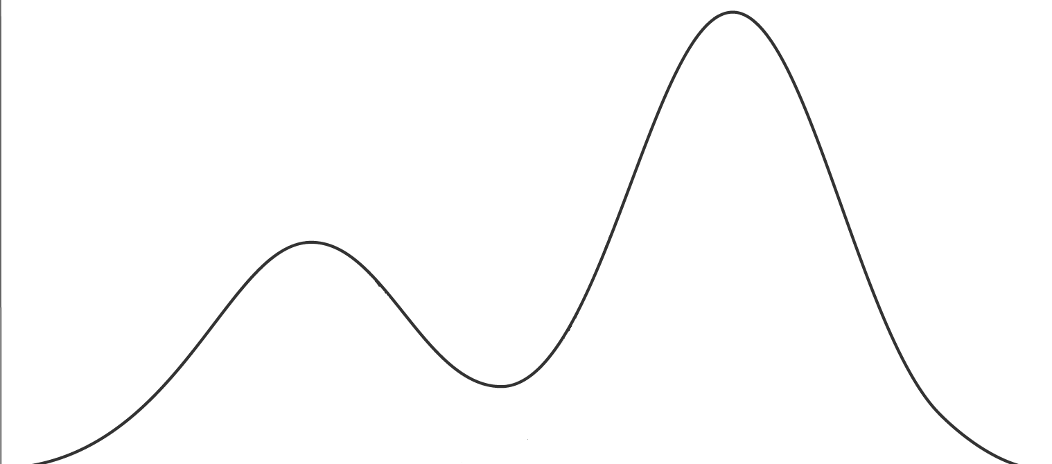
Generative Classifiers – Example 1: Studying Students
For example, suppose we have a class of students. Each student either studies or doesn’t study before taking an exam. Consider the distribution of exam scores below. How might this distribution come to be?
Average for people who did study
Average for people who didn’t study
Exam Score

Slide 14
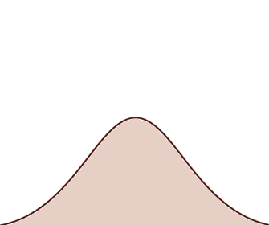
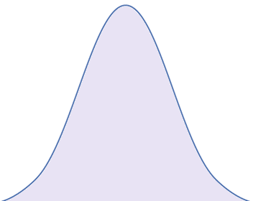


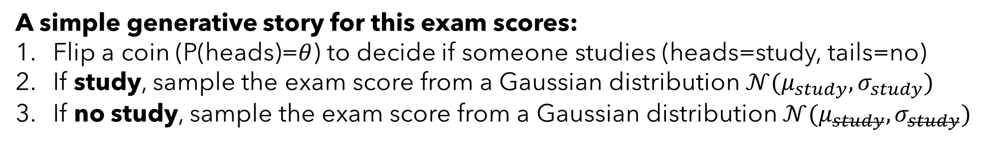



Generative Classifiers – Example 1: Studying Students
A simple generative story for this exam scores:
Flip a coin (P(heads)=$θ$) to decide if someone studies (heads=study, tails=no)
If study, sample the exam score from a Gaussian distribution $𝒩(μ_{study}, σ_{study})$
If no study, sample the exam score from a Gaussian distribution $𝒩(μ_{study}, σ_{study})$
$$𝒩(μ_{study}, σ_{study})$$
$$𝒩(μ_{study}, σ_{study})$$
P(study)=$1−θ$
P(study)=$θ$
Exam Score

Slide 15
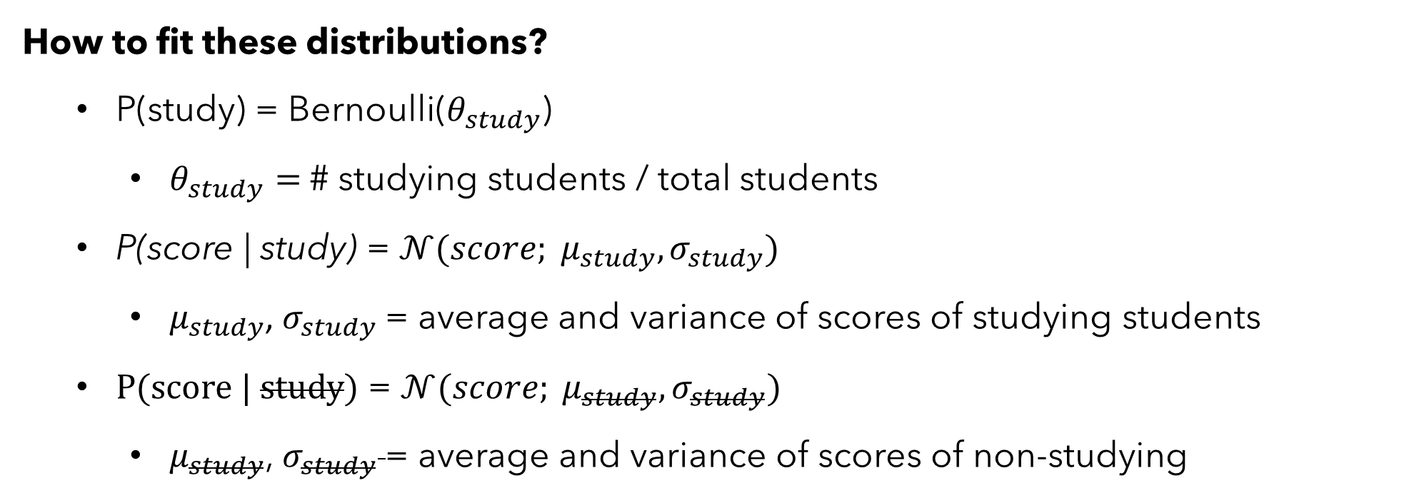
Generative Classifiers – Example 1: Studying Students
How to fit these distributions?
P(study) = Bernoulli($θ_{study}$)
$θ_{study}=$# studying students / total students
P(score | study) = $𝒩(score; μ_{study}, σ_{study})$
$μ_{study}$, $σ_{study}$= average and variance of scores of studying students
P(score | study) = $𝒩(score; μ_{study}, σ_{study})$
$μ_{study}$, $σ_{study}$= average and variance of scores of non-studying

Slide 16
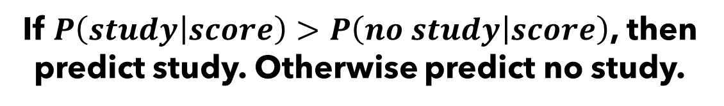
Generative Classifiers – Example 1: Studying Students
Given an observed exam score, how would this story help us predict whether the student studied? Bayes rule to the rescue again.
$$P\left(study | score\right)∝P\left(score | study\right)P(study)$$
$$=𝒩\left(score; μ_{study}, σ_{study}\right)θ$$
$$P\left(no study | score\right)∝P\left(score | no study\right)P(no study)$$
$$=𝒩\left(score; μ_{study}, σ_{study}\right)\left(1−θ\right)$$
If $P\left(study | score\right)>P\left(no study | score\right)$, then predict study. Otherwise predict no study.

Slide 17
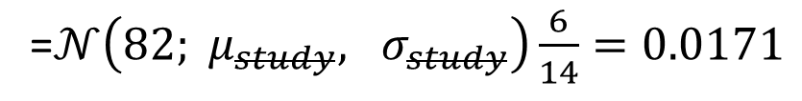
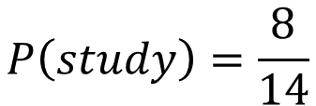
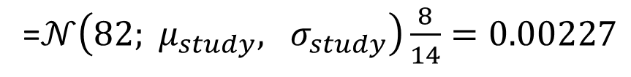
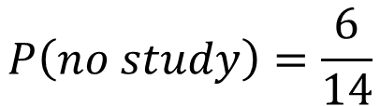
Generative Classifiers – Example 1: Studying Students
Study? | Score
Yes | 87
Yes | 89
Yes | 87
Yes | 88
Yes | 91
Yes | 97
Yes | 91
Yes | 93
No | 80
No | 77
No | 64
No | 75
No | 91
$$P\left(study\right)=\frac{8}{14}$$
$$P\left(no study\right)=\frac{6}{14}$$
$P\left(score|study\right)=$ $𝒩(score; μ_{study}=90.375, σ_{study}=3.19)$
$P\left(score|study\right)=$ $𝒩(score; μ_{study}=77.4, σ_{study}=8.68)$
See a new score of 82, did the student study?
$$P\left(study | 82\right)∝P\left(82|study\right)P(study)$$
=$𝒩\left(82; μ_{study}, σ_{study}\right)\frac{8}{14}=0.00227$
$$P\left(no study | 82\right)∝P\left(82|no study\right)P(no study)$$
=$𝒩\left(82; μ_{study}, σ_{study}\right)\frac{6}{14}=0.0171$

Slide 18
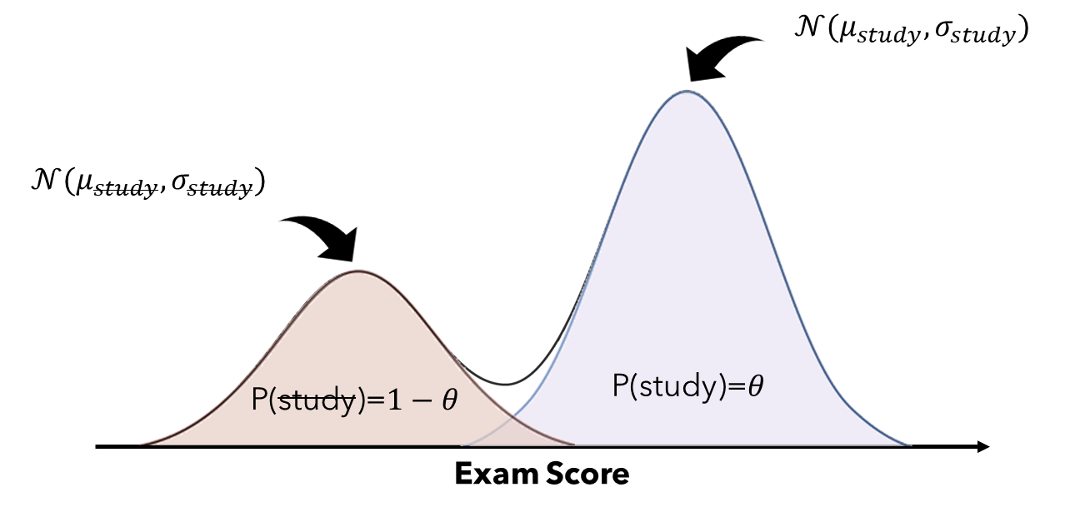
Generative Classifiers – Example 1: Studying Students
This example had binary labels (y=study / no study) and only a single continuous feature (x=exam score). But we can do similar things with many more features or classes.

Slide 19
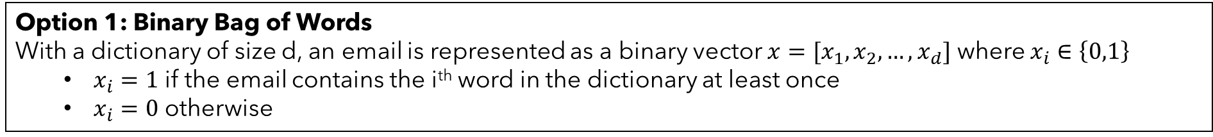
Generative Stories – Example 2: Email Classification
Consider the task of classifying email as either Normal or Spam based on the words in the email.
Output: $y∈\left\{Normal, Spam\right\}$ or equivalently $y∈\{0,1\}$
Input: List of M words occurring in an email. How to represent this?
Popular approach is “bag-of-words”
Option 1: Binary Bag of Words
With a dictionary of size d, an email is represented as a binary vector $x=[x_{1}, x_{2}, …, x_{d}]$ where $x_{i}∈\left\{0,1\right\}$
$x_{i}=1$ if the email contains the i^{th} word in the dictionary at least once
$x_{i}=0$ otherwise
Option 2: Multinomial Bag of Words
With a dictionary of size d, an email is represented as a binary vector $x=[x_{1}, x_{2}, …, x_{d}]$ where $x_{i}∈ℕ_{0}$
$x_{i}:$ non-negative integer occurrence count of the i^{th} word in the dictionary

Slide 20

Generative Stories – Example 2: Email Classification
Option 1: Binary Bag of Words
With a dictionary of size d, an email is represented as a binary vector $x=[x_{1}, x_{2}, …, x_{d}]$ where $x_{i}∈\left\{0,1\right\}$
$x_{i}=1$ if the email contains the i^{th} word in the dictionary at least once
$x_{i}=0$ otherwise
… source for a partner abroad who can accommodate HUGE RESOURCES.
Each document represented by a vector showing which words occurred:
partner
huge
resources
$$x=\left[0, 1, 0, 0, 0, 1,…,0, 0 , 0 ,1 ,0\right]$$
assignment
research
meeting
Vector has length equal to the number of words in our vocabulary (d).

Slide 21
Generative Stories – Example 2: Email Classification
A simple generative story for this spam emails:
Flip a weighted coin to determine Normal or Spam
If Normal, sample an x vector from P(x|normal)
If Spam, sample an x vector from P(x|spam)
Would need to learn:
Prior distribution $P\left(y\right)$ as the prior probability of being Normal, Spam, or Advertisement
P(normal) = # normal / total. P(spam) = # spam / total. P(ad) = # ad / total.
Conditional distributions $P\left(x| y=normal\right),P\left(x | y=spam\right)$
P(x | y=normal) = (# normal emails where the exact set of words in x occur) / (# normal emails)
P(x | y=spam) = (# spam emails where the exact set of words in x occur) / (# spam emails)
Problem: How do we fit these distributions?

Slide 22
Estimating Joint Distributions over Discrete Variables

Slide 23


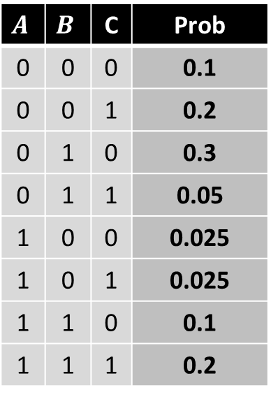

Estimating Joint Distributions over Discrete Variables
Joint Distributions over Discrete Variables
$$A$$ | $$B$$ | C | Prob
0 | 0 | 0 | 0.1
0 | 0 | 1 | 0.2
0 | 1 | 0 | 0.3
0 | 1 | 1 | 0.05
1 | 0 | 0 | 0.025
1 | 0 | 1 | 0.025
1 | 1 | 0 | 0.1
1 | 1 | 1 | 0.2
$$\text{P}\text{(}\text{A}\text{=0, }\text{B}\text{=0, }\text{C}\text{=0)}$$
Recipe for writing a joint distribution of M discrete variables:
Make a table listing all value combinations of the variables. (M Boolean variables → 2^{M} rows)
For each value combination, define how probable it is
Due to axioms of probability, these probabilities must sum to 1.
$$\text{P}\text{(}\text{A}\text{=1, }\text{B}\text{=0, }\text{C}\text{=1)}$$
Example: Joint distribution over Boolean random variables A,B,C

Slide 24
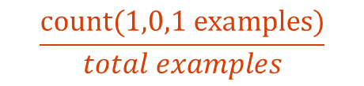
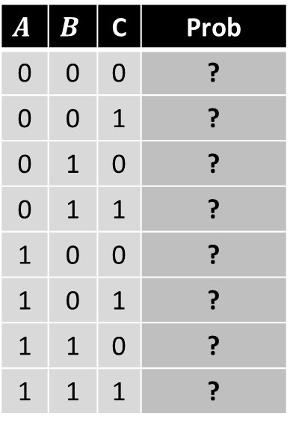
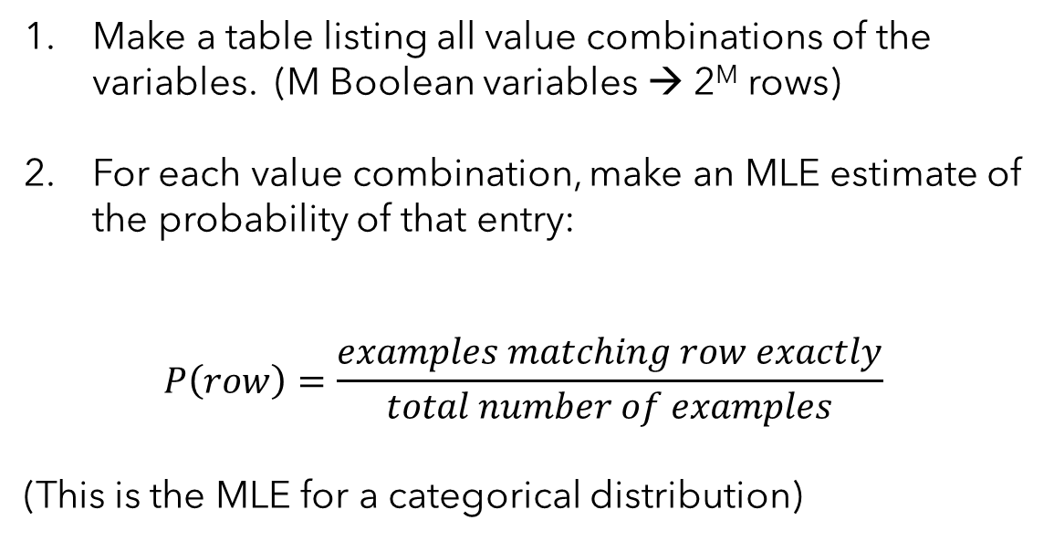
Estimating Joint Distributions over Discrete Variables
Learning Joint Distributions over Discrete Variables
$$A$$ | $$B$$ | C | Prob
0 | 0 | 0 | ?
0 | 0 | 1 | ?
0 | 1 | 0 | ?
0 | 1 | 1 | ?
1 | 0 | 0 | ?
1 | 0 | 1 | ?
1 | 1 | 0 | ?
1 | 1 | 1 | ?
Recipe for estimating a joint distribution of M discrete variables from date:
Make a table listing all value combinations of the variables. (M Boolean variables → 2^{M} rows)
For each value combination, make an MLE estimate of the probability of that entry:
$$P\left(row\right)=\frac{examples matching row exactly}{total number of examples}$$
(This is the MLE for a categorical distribution)
$$\frac{count(1,0,1 examples)}{total examples}$$
Example: Joint distribution over Boolean random variables A,B,C

Slide 25
Example of Estimating Joint Distributions over Discrete Variables
Our Data:
Out Joint Distribution:
Likes Math | Reads ML News | At Least Junior
0 | 0 | 1
1 | 0 | 1
1 | 1 | 1
0 | 0 | 1
1 | 1 | 1
0 | 1 | 1
0 | 1 | 1
1 | 1 | 1
1 | 1 | 0
1 | 0 | 0
Likes Math | Reads ML News | At Least Junior | Prob
0 | 0 | 0
0 | 0 | 1
0 | 1 | 0
0 | 1 | 1
1 | 0 | 0
1 | 0 | 1
1 | 1 | 0
1 | 1 | 1

Slide 26
Example of Estimating Joint Distributions over Discrete Variables
Our Data:
Out Joint Distribution:
Likes Math | Reads ML News | At Least Junior
0 | 0 | 1
1 | 0 | 1
1 | 1 | 1
0 | 0 | 1
1 | 1 | 1
0 | 1 | 1
0 | 1 | 1
1 | 1 | 1
1 | 1 | 0
1 | 0 | 0
Likes Math | Reads ML News | At Least Junior | Prob
0 | 0 | 0 | 0
0 | 0 | 1 | 0.2
0 | 1 | 0 | 0
0 | 1 | 1 | 0.2
1 | 0 | 0 | 0.1
1 | 0 | 1 | 0.1
1 | 1 | 0 | 0.1
1 | 1 | 1 | 0.3

Slide 27
Estimating Joint Distributions over Discrete Variables

Slide 28
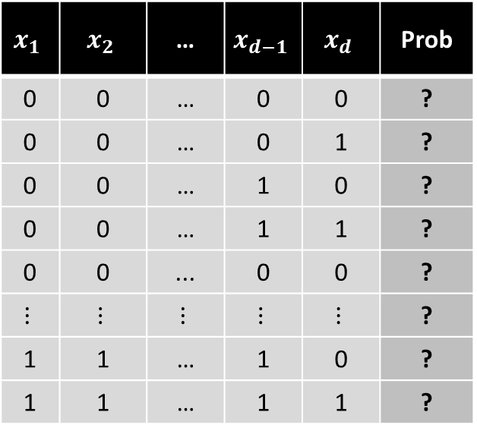
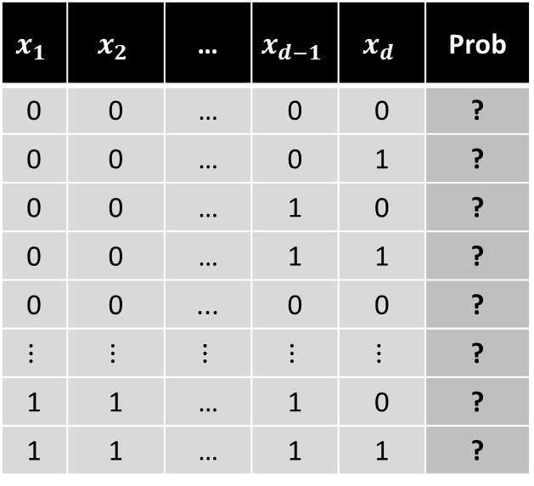
Generative Stories – Example 2: Email Classification
Prior distribution $P\left(y\right)$ as the prior probability of being Normal, Spam, or Advertisement
P(normal) = # normal / total. P(spam) = # spam / total. P(ad) = # ad / total.
Conditional distributions $P\left(x| y=normal\right),P\left(x | y=spam\right)$
P(x | y=normal) = (# normal emails where the exact set of words in x occur) / (# normal emails)
P(x | y=spam) = (# spam emails where the exact set of words in x occur) / (# spam emails)
P(x | y=normal)
P(x | y=spam)
$$x_{1}$$ | $$x_{2}$$ | … | $$x_{d−1}$$ | $$x_{d}$$ | Prob
0 | 0 | … | 0 | 0 | ?
0 | 0 | … | 0 | 1 | ?
0 | 0 | … | 1 | 0 | ?
0 | 0 | … | 1 | 1 | ?
0 | 0 | ... | 0 | 0 | ?
$$⋮$$ | $$⋮$$ | $$⋮$$ | $$⋮$$ | $$⋮$$ | ?
1 | 1 | … | 1 | 0 | ?
1 | 1 | … | 1 | 1 | ?
$$x_{1}$$ | $$x_{2}$$ | … | $$x_{d−1}$$ | $$x_{d}$$ | Prob
0 | 0 | … | 0 | 0 | ?
0 | 0 | … | 0 | 1 | ?
0 | 0 | … | 1 | 0 | ?
0 | 0 | … | 1 | 1 | ?
0 | 0 | ... | 0 | 0 | ?
$$⋮$$ | $$⋮$$ | $$⋮$$ | $$⋮$$ | $$⋮$$ | ?
1 | 1 | … | 1 | 0 | ?
1 | 1 | … | 1 | 1 | ?
These are huge! $2∗2^{d}$ entires.

Slide 29

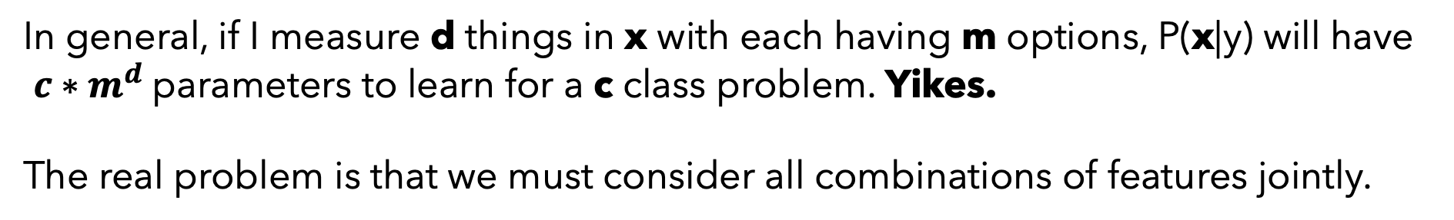
Naïve Bayes Model Idea
In general, if I measure d things in x with each having m options, P(x|y) will have $c∗m^{d}$parameters to learn for a c class problem. Yikes.
The real problem is that we must consider all combinations of features jointly.
The Naïve Bayes Assumption:
Each feature is conditionally independent given the class label.
$$P\left(x | y\right)=\prod_{i=1}^{d}{P(x_{i}|y)}$$

Slide 30
Reminders about (conditional) independence

Slide 31
Reminders about (conditional) independence
Independence: If two random variables X and Y are independent, then:
$$P\left(X,Y\right)=P\left(X\right)P\left(Y\right), P\left(X | Y\right)=P\left(X\right), P\left(Y | X\right)=P(Y)$$
Conditional Independence: If two random variables X and Y are conditionally independent given Z, then:
$$P\left(X,Y|Z\right)=P\left(X|Z\right)P\left(Y|Z\right), P\left(X | Y,Z\right)=P\left(X|Z\right), P\left(Y | X,Z\right)=P(Y|Z)$$

Slide 32
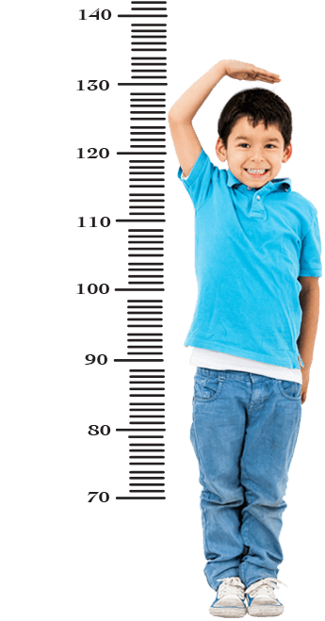
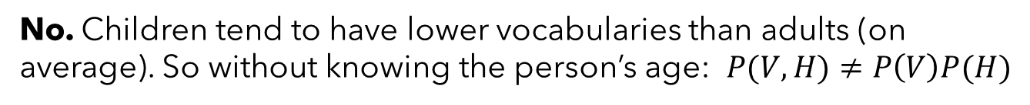
Reminders about (conditional) independence
Example: Define three random variables:
H: A person’s height
V: How many words they know
A: A person’s age
Are height and vocabulary size independent?
def children: Short people with small vocabularies.
No. Children tend to have lower vocabularies than adults (on average). So without knowing the person’s age: $P(V,H)≠P\left(V\right)P(H)$
However, if I tell you their age… its likely that these are independent. $P\left(V,H | A\right)=P\left(V | A\right)P(H|A)$
Events that are dependent in general, can be made independent given some other observation.

Slide 33
Reminders about (conditional) independence

Slide 34

Naïve Bayes Model Idea
The Naïve Bayes Assumption:
Each feature is conditionally independent given the class label.
$$P\left(x | y\right)=\prod_{i=1}^{d}{P(x_{i}|y)}$$

Slide 35

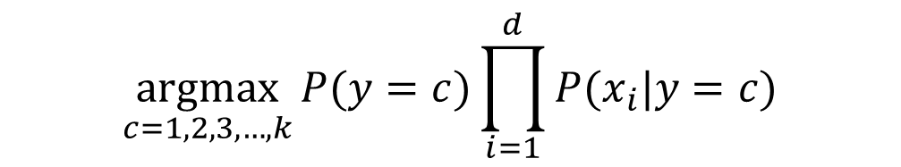
Naïve Bayes Model Idea
How does this help?
$$P\left(y | x\right)∝P\left(x | y\right)P(y)$$
Bayes Theorem
$$=P(y)\prod_{i=1}^{d}{P(x_{i}|y)}$$
Naïve Bayes Assumption
Can make predictions this way:
$$\underset{c=1,2,3,…,k}{argmax}{P(y=c)\prod_{i=1}^{d}{P(x_{i}|y=c)}}$$

Slide 36
Updating our Generative Story for Spam Emails to be “Naïve”
A “naïve” generative story for this spam emails:
Flip a weighted coin to determine Normal or Spam.
For each word i, flip a weighted coin to determine if it is included in the email. Let the weight of the coin depend on whether the email is normal or spam.
Would need to learn:
Prior distribution $P\left(y\right)$ as the prior probability of being Normal, Spam, or Advertisement
P(normal) = # normal / total. P(spam) = # spam / total. P(ad) = # ad / total.
Conditional distributions $P\left(x| y=normal\right),P\left(x | y=spam\right)$
P(x_i | y=normal) = (# normal emails with word i) / (# normal emails)
P(x_i| y=spam) = (# spam emails with word i) / (# spam emails)
Problem: How do we fit these distributions?

Slide 37
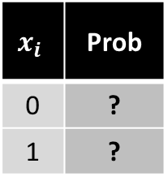


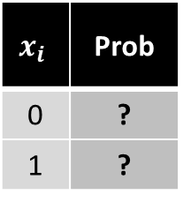
Updating our Generative Story for Spam Emails to be “Naïve”
Would need to learn:
Prior distribution $P\left(y\right)$ as the prior probability of being Normal, Spam, or Advertisement
P(normal) = # normal / total. P(spam) = # spam / total. P(ad) = # ad / total.
Conditional distributions $P\left(x| y=normal\right),P\left(x | y=spam\right)$
P($x_{i}$| y=normal) = (# normal emails with word i) / (# normal emails)
P($x_{i}$| y=spam) = (# spam emails with word i) / (# spam emails)
P($x_{i}$| y=spam)
P($x_{i}$| y=normal)
$$x_{i}$$ | Prob
0 | ?
1 | ?
$$x_{i}$$ | Prob
0 | ?
1 | ?
x d
x d
Now we only need to learn 2*2d values. (2*d if you take advantage of axioms)

Slide 38
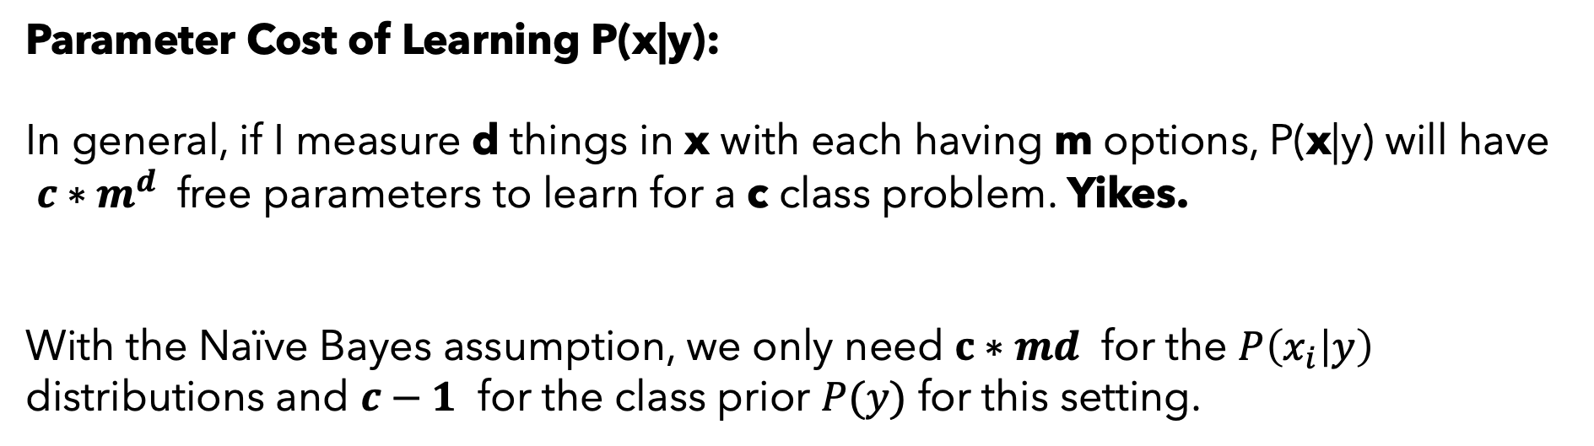
Naïve Bayes Model Idea
Parameter Cost of Learning P(x|y):
In general, if I measure d things in x with each having m options, P(x|y) will have $c∗m^{d}$ free parameters to learn for a c class problem. Yikes.
With the Naïve Bayes assumption, we only need $c∗md$ for the $P\left(x_{i} | y\right)$ distributions and $c−1$ for the class prior $P(y)$ for this setting.

Slide 39
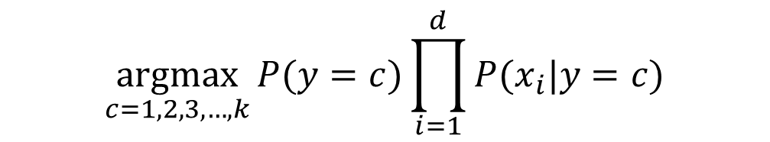
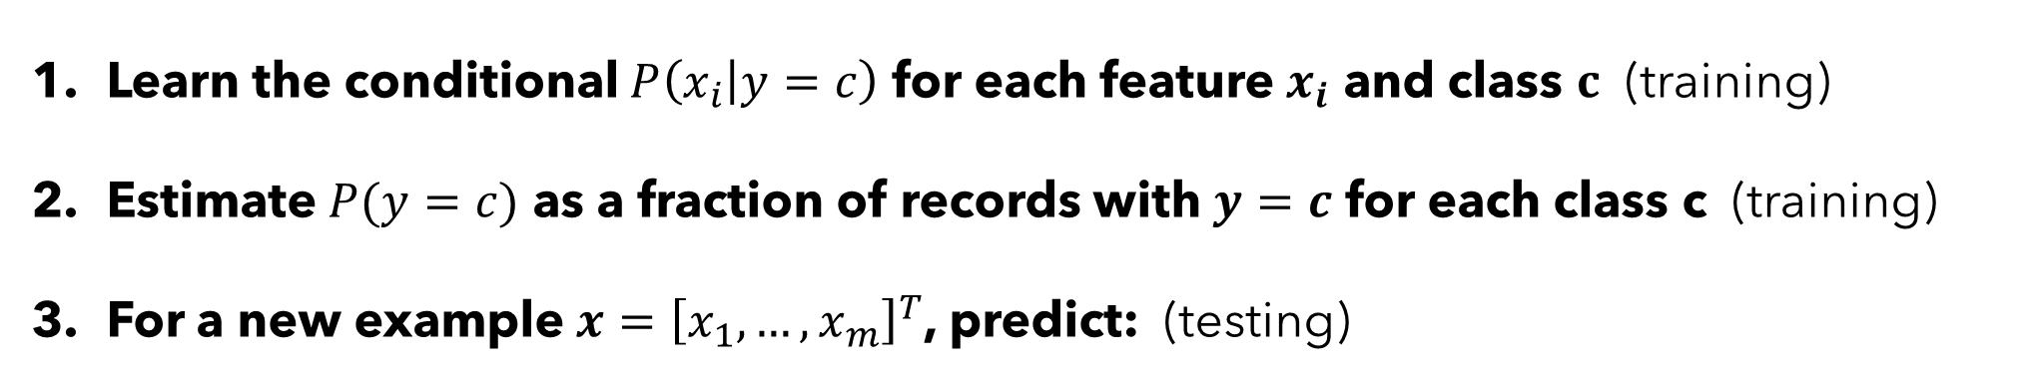
Naïve Bayes Model Idea
The Naïve Bayes Model Steps:
Learn the conditional $P\left(x_{i} | y=c\right)$ for each feature $x_{i}$ and class $c$ (training)
Estimate $P(y=c)$ as a fraction of records with $y=c$ for each class c (training)
For a new example $x={\left[x_{1},…, x_{m}\right]}^{T}$, predict: (testing)
$$\underset{c=1,2,3,…,k}{argmax}{P(y=c)\prod_{i=1}^{d}{P(x_{i}|y=c)}}$$

Slide 40
Naïve Bayes Model Idea
An example: Suppose I measure three things about each of you:
UpperLowerClass {Lower, Upper}
LikesMath {Yes, No}
ReadsML {Yes, No}
And want to predict whether you think the class is easy/moderate/hard:
CS434 {Easy, Moderate, Hard}
What do examples look like?
( [Lower, Yes, No], Moderate ), ( [Upper, Yes, Yes], Easy ), ( [Lower, No, Yes], Difficult] ), ( [Upper, Yes, Yes], Moderate )

Slide 41




Naïve Bayes Model Idea
Now need to learn the following distributions:
$$P(\text{UpperLower}|\text{CS}\text{434})$$
$$P(\text{CS}\text{434})$$
P(lower | easy) | P(lower | moderate) | P(lower | hard)
P(upper | easy) | P(upper | moderate) | P(upper | hard)
P(CS434=easy)
P(CS434=moderate)
P(CS434=hard)
4 free parameters
2 free parameters
$$P(LikesMath|\text{CS}\text{434})$$
$$P(ReadsML|\text{CS}\text{434})$$
P(0 | easy) | P(0 | moderate) | P(0| hard)
P(1 | easy) | P(1 | moderate) | P(1 | hard)
P(0 | easy) | P(0 | moderate) | P(0| hard)
P(1 | easy) | P(1 | moderate) | P(1 | hard)
3 free parameters
3 free parameters

Slide 42


Let’s try fitting one of these to the class:
Series of polls to fill tables: A=Easy B=Moderate C=Hard
$$P(\text{UpperLower}|\text{CS}\text{434})$$
$$P(\text{CS}\text{434})$$
P(CS434=easy)
P(CS434=moderate)
P(CS434=hard)
P(lower | easy) | P(lower | moderate) | P(lower | hard)
P(upper | easy) | P(upper | moderate) | P(upper | hard)
$$P(LikesMath|\text{CS}\text{434})$$
$$P(ReadsML|\text{CS}\text{434})$$
P(0 | easy) | P(0 | moderate) | P(0| hard)
P(1 | easy) | P(1 | moderate) | P(1 | hard)
P(0 | easy) | P(0 | moderate) | P(0| hard)
P(1 | easy) | P(1 | moderate) | P(1 | hard)

Slide 43

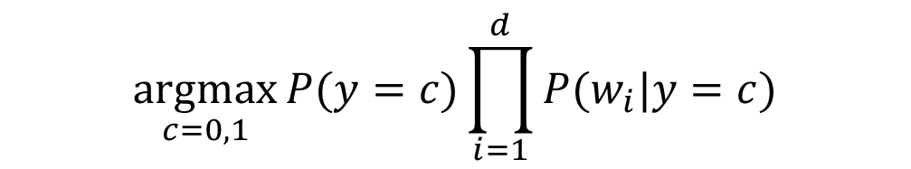
Practical Problems with Naïve Bayes
The zero-probability problem:
$$\underset{c=0,1}{argmax}{P(y=c)\prod_{i=1}^{d}{P(w_{i}|y=c)}}$$
If any one of these terms is 0 for an instance, whole thing is 0.
Why might that happen?
What if a new email contains a word we never saw in the training emails?
$$P\left(w | spam\right)=0 and P\left(w | not spam\right)=0$$

Slide 44
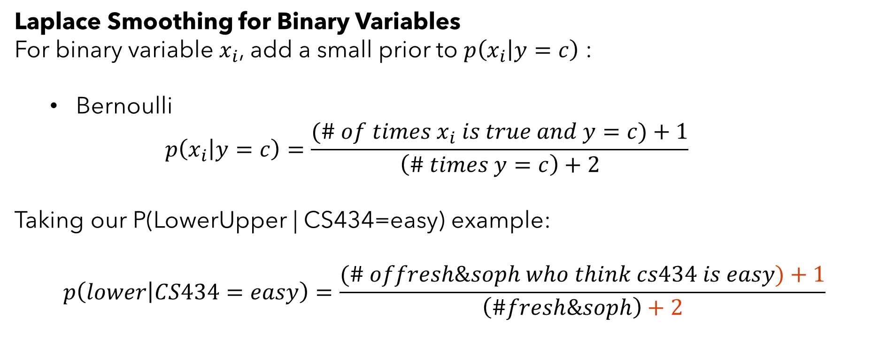
Practical Problems with Naïve Bayes
Laplace Smoothing for Binary Variables
For binary variable $x_{i}$, add a small prior to $p\left(x_{i} | y=c\right)$ :
Bernoulli
$$p\left(x_{i} | y=c\right)=\frac{(\# of times x_{i} is true and y=c)+1}{\left(\# times y=c\right)+2}$$
Taking our P(LowerUpper | CS434=easy) example:
$$p\left(lower | CS434=easy\right)=\frac{(\# offresh\&soph who think cs434 is easy)+1}{\left(\#fresh\&soph\right)+2}$$
This is just adding a prior to the estimated conditional distributions.
Specifically, a Beta(1,1) prior.

Slide 45
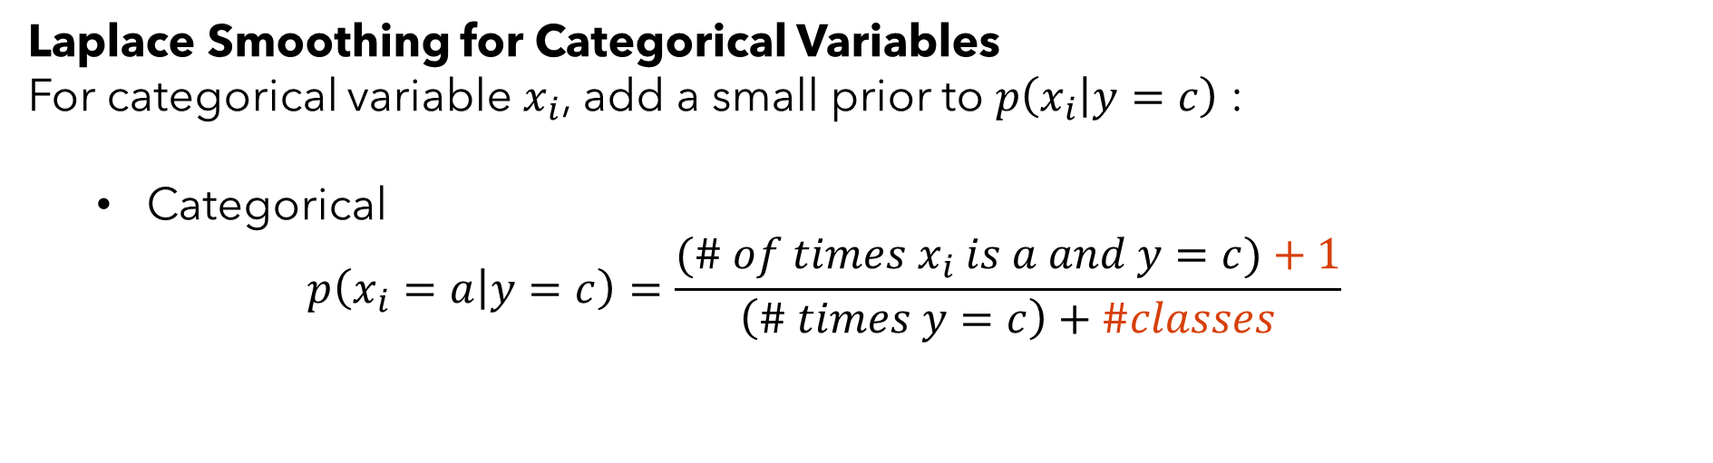
Practical Problems with Naïve Bayes
Laplace Smoothing for Categorical Variables
For categorical variable $x_{i}$, add a small prior to $p\left(x_{i} | y=c\right)$ :
Categorical
$$p\left(x_{i}=a | y=c\right)=\frac{(\# of times x_{i} is a and y=c)+1}{\left(\# times y=c\right)+\#classes}$$
This is just adding a prior to the estimated conditional distributions.
Specifically, a Dirichlet prior.

Slide 46
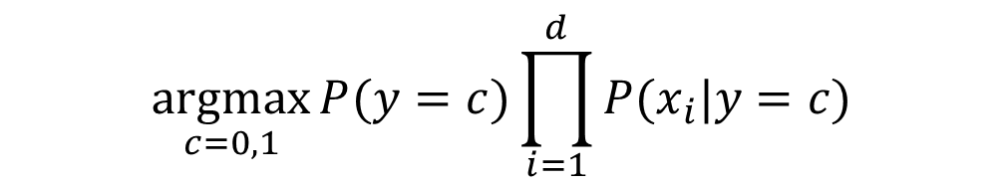
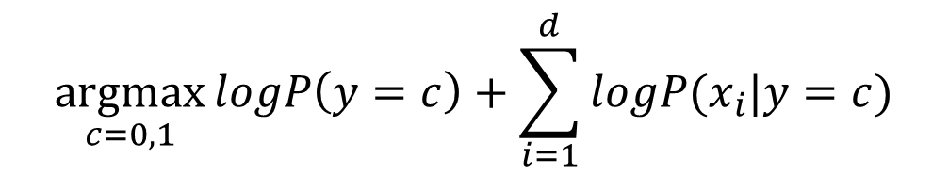
Practical Problems with Naïve Bayes
Taking the product of a bunch of probabilities is prone to underflow errors:
$$\underset{c=0,1}{argmax}{P(y=c)\prod_{i=1}^{d}{P(x_{i}|y=c)}}$$
0.0001*0.001*0.02*0.01*...
Let’s do this in log space:
$$\underset{c=0,1}{argmax}{logP\left(y=c\right)+\sum_{i=1}^{d}{logP(x_{i}|y=c)}}$$

Slide 47
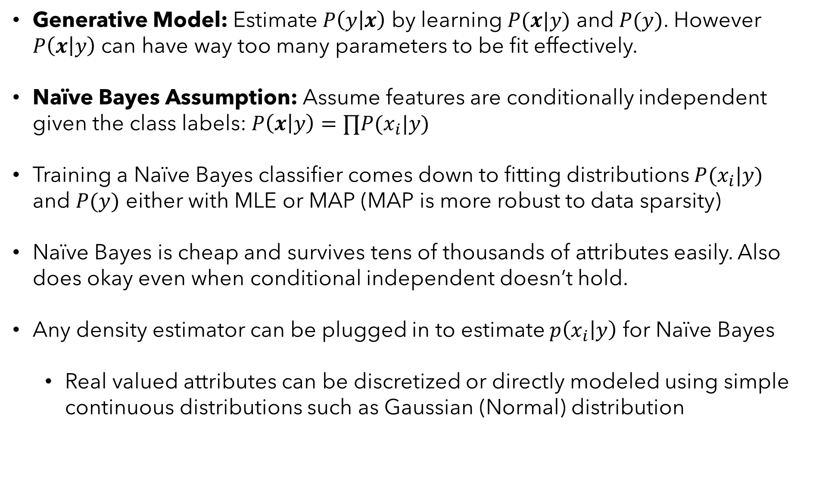
Summary of Naïve Bayes Classifier
Generative Model: Estimate $P\left(y | x\right)$ by learning $P(x|y)$ and $P(y)$. However $P\left(x | y\right)$ can have way too many parameters to be fit effectively.
Naïve Bayes Assumption: Assume features are conditionally independent given the class labels: $P\left(x | y\right)=∏P(x_{i}|y)$
Training a Naïve Bayes classifier comes down to fitting distributions $P(x_{i}|y)$ and $P(y)$ either with MLE or MAP (MAP is more robust to data sparsity)
Naïve Bayes is cheap and survives tens of thousands of attributes easily. Also does okay even when conditional independent doesn’t hold.
Any density estimator can be plugged in to estimate $p\left(x_{i} | y\right)$ for Naïve Bayes
Real valued attributes can be discretized or directly modeled using simple continuous distributions such as Gaussian (Normal) distribution

Slide 48
Example Naïve Bayes
In-Class Coded Example 1:
Categorical Naïve Bayes on Tumor Classification

Slide 49
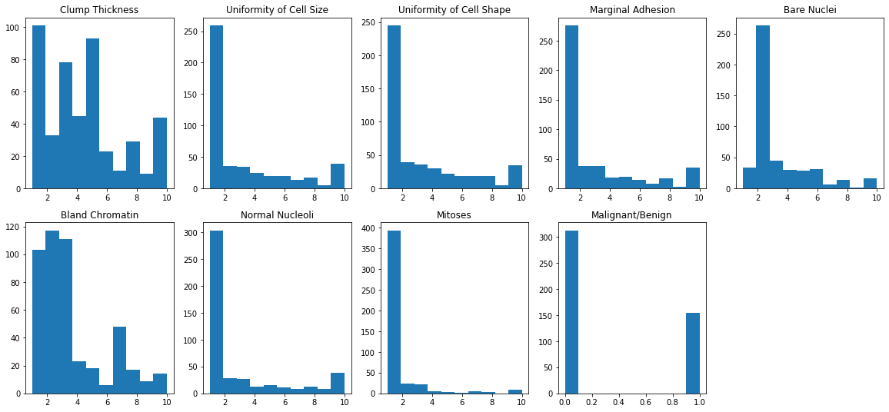
Categorical Naïve Bayes on Tumor Classification

Slide 50
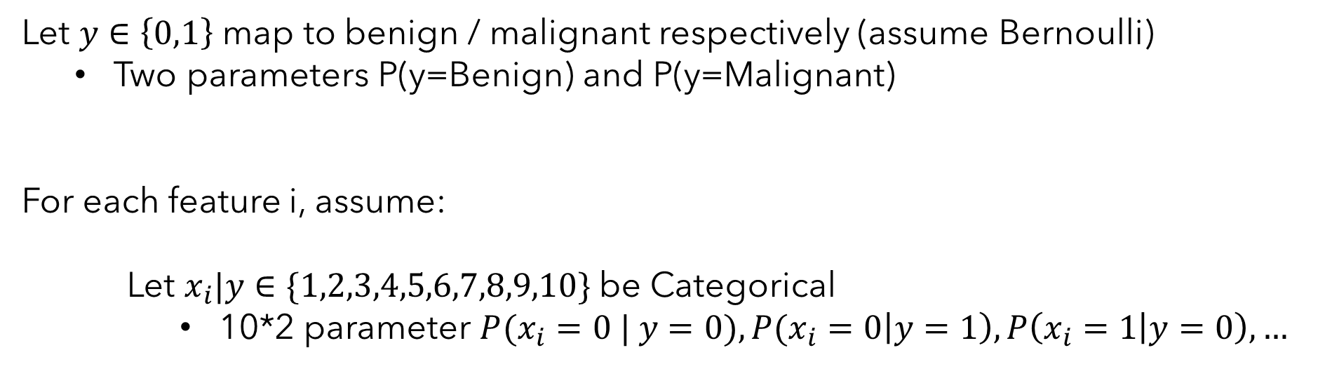
Categorical Naïve Bayes on Tumor Classification
Let $y∈\left\{0,1\right\}$ map to benign / malignant respectively (assume Bernoulli)
Two parameters P(y=Benign) and P(y=Malignant)
For each feature i, assume:
Let $x_{i}|y∈\{1,2,3,4,5,6,7,8,9,10\}$ be Categorical
10*2 parameter $P(x_{i}=0 | y=0), P(x_{i}=0\left|y=1\right), P\left(x_{i}=1 | y=0\right),…$
Need to learn the distributions:
$P\left(y\right) and P\left(x_{i} | y_{i}\right)∀i$

Slide 51
Example Naïve Bayes
In-Class Coded Example 2:
Gaussian Naïve Bayes on Winegrape Classification

Slide 52
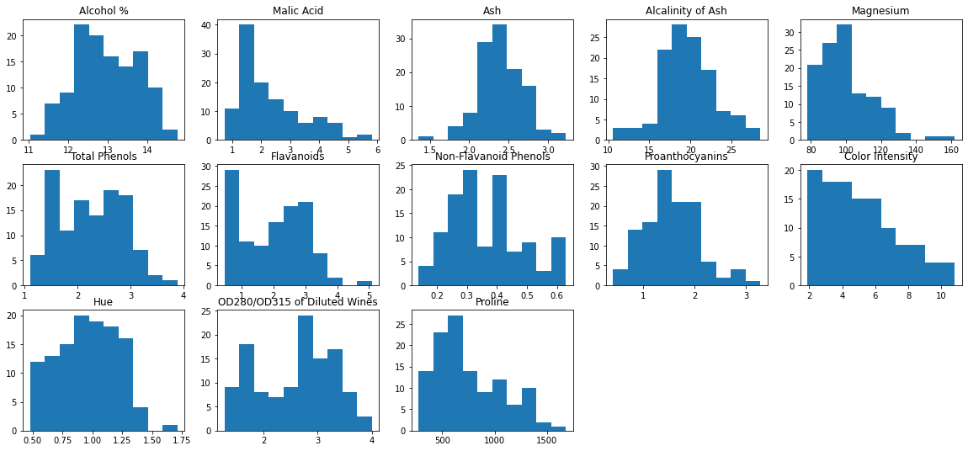
Gaussian Naïve Bayes on Winegrape Classification

Slide 53
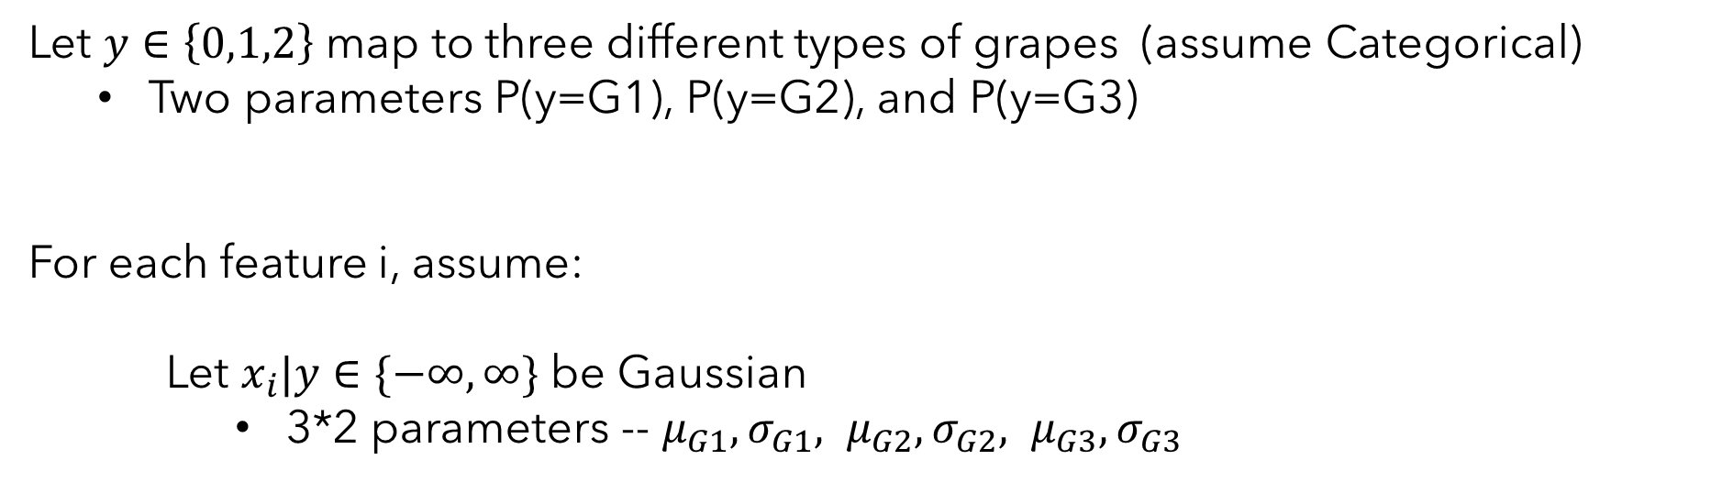
Gaussian Naïve Bayes on Winegrape Classification
Let $y∈\left\{0,1,2\right\}$ map to three different types of grapes (assume Categorical)
Two parameters P(y=G1), P(y=G2), and P(y=G3)
For each feature i, assume:
Let $x_{i}|y∈\{−∞, ∞\}$ be Gaussian
3*2 parameters -- $μ_{G1}, σ_{G1}, μ_{G2},σ_{G2}, μ_{G3}, σ_{G3}$
Need to learn the distributions:
$P\left(y\right) and P\left(x_{i} | y_{i}\right)∀i$

Slide 54
Colab Notebook Demo
You can check out the Colab notebook here:
https://colab.research.google.com/drive/1_7306psnPOFgrgUgAGQUm8XEL_3QZ6FO?usp=sharing

Slide 55
Next time
Next Time: We’ll talk about maximum margin classifiers – specifically SVMs!

